Slide 1
Red Stripe FootBall Fantasy League Application
Group 18
Group Members:
Leon Facey
Nathan Nash
Jodi-Marie Taylor
Romario Tomlin

Slide 2
Statement of Problem
The Red Stripe Premier League is the biggest football league in Jamaica. However, it is not well publicized across Jamaica or the Caribbean. Therefore, it is not maximizing its audience which affects different areas in the league. Also, Individuals are not able to access up to date information on scores, matches and breaking news easily which leave the fans disengaged. Therefore, there is a lack of awareness, knowledge and exposure of the league. Having this application will aid in improving these areas..

Slide 3
Motivation
Being football enthusiasts, the group wanted to develop an app that would be fun , interesting and geared toward the development of Jamaican football. Fantasy football games are becoming more popular with several games being developed for different leagues around the world. Therefore, it would be a great opportunity to bring an application to Jamaica’s biggest league. We believe it will be an exciting, educational and enlightening experience for users and players in Jamaica.

Slide 4
Description
The Red Stripe football fantasy league app will allow users to create a team and purchase players with a given balance and select customizable line ups in order to compete against other users. As the season progresses, after each match, every user will be given a score depending on how each player of their team played. Every week the users will be ranked according to their score until after the season. At that point, the top 5 users will be given additional money to carry over into the next season. Therefore, the aim of a user is to score as many points as possible during the season. The application will also allow for users to view local football news as well as the match time, location and other details on every match.

Slide 5
Scope
The football fantasy league app will be a web application for the local Red Stripe Premier League. Users will only be allowed to select 1 team with 11 players from a list of all the players participating in the league as well as three bench players. The user can select among 3 formations which will dictate how they choose their players. Depending on the formation, users can select a certain amount of Goal Keepers, Midfielders, Defenders and Strikers.The balance given will be a fixed $1 million JMD on sign up. Players will be priced differently depending on how well they performed the previous season and based on popularity. Users are only allowed to select max 3 players from a premier league team. However, users are only allowed to make changes to their teams 24 hours before each match is played. The project will be conducted over a period of 4 months.

Slide 6
Objectives
To keep users updated on current news and statistics in the premier league.
To have an attractive and user friendly interface for ease of use
To provide a sense of community amongst users
To allow for customization
To provide an interactive fantasy premier league
To give the Red Stripe league more recognition
To give the students of UWI an opportunity to interact with the UWI football team
To provide exposure for the league

Slide 7
Additional Information
The application wil be built using python with the web framework django
The database management system that will be used is Mysql
It will have the following tables
User, Team , Players and Matches (Note, this may be more as we progress in the project)
The application will be constantly maintained by administrators in order to keep player scores, matches and relevant news up to date. However, most of the information will be done through web crawling http://uk.livescore.eurosport.com/football/digicel-premier-league/ which is the official site for the premier league.

Slide 8
Computation (Calculations)
Calculate Players scores
Calculate balance of the user
Calculate weekly score (summation of player’s scores)
Calculate total score (summation of weekly scores)
Show rankings
Calculate Player Price

Slide 9
Player scores
Points Allocated:
Yellow Card ---> -2 points
Red Card ---> -5 points
Assist ---> 3 points
Appearance ---> 1 point
Goal ---> 5 points
Clean Sheet ---> 2 points
Own Goal ---> -2 points
Notes:
Goals
In football, goals win games, and in fantasy football they’re your primary source of
points. Points are awarded on a sliding scale based on position (and therefore likelihood
of scoring).
Assists
Players who set up a goal are given two points, regardless of position.
Clean sheets
Two clean sheet points are awarded to goalkeepers and defenders whose team
successfully prevents the opposition from scoring. In order to qualify for clean sheet
points, a player must have been on the pitch for at least 45 minutes.
Negative points
Points are taken away for negative contributions. For every red card and yellow card
points are deducted.
The cardinal sin in fantasy football is the red card. Players sent off lose their teams
three points a time and yellow are is 2 points.

Slide 10
Formula
Formula: points = (ycCount * -2) + (rcCount * -5) + (assistCount * 3) + (appearance) + (goalsScored * 5) + (cleanSheet) + (ownGoalCount * -2)
player_score = player_score + points

Slide 11
DIAGRAMS

Slide 12
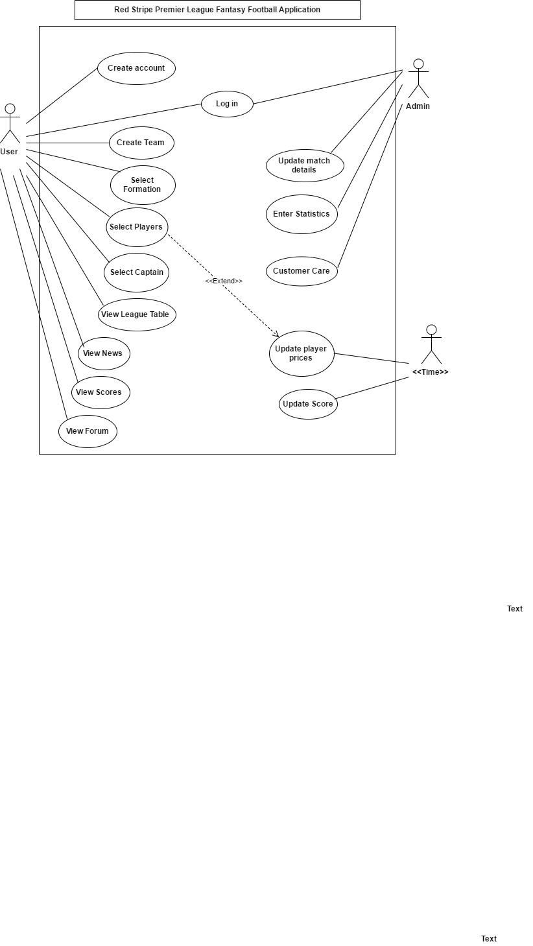
Use Case

Slide 13
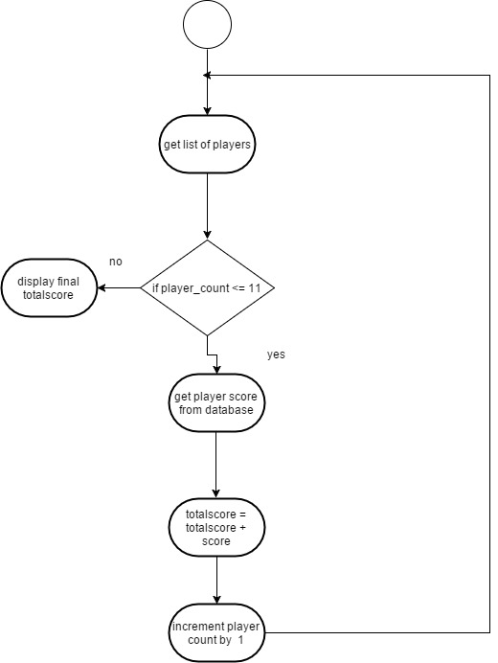
Activity Diagram - Calculating User Total Score

Slide 14
Activity Diagram - Selecting Players

Slide 15
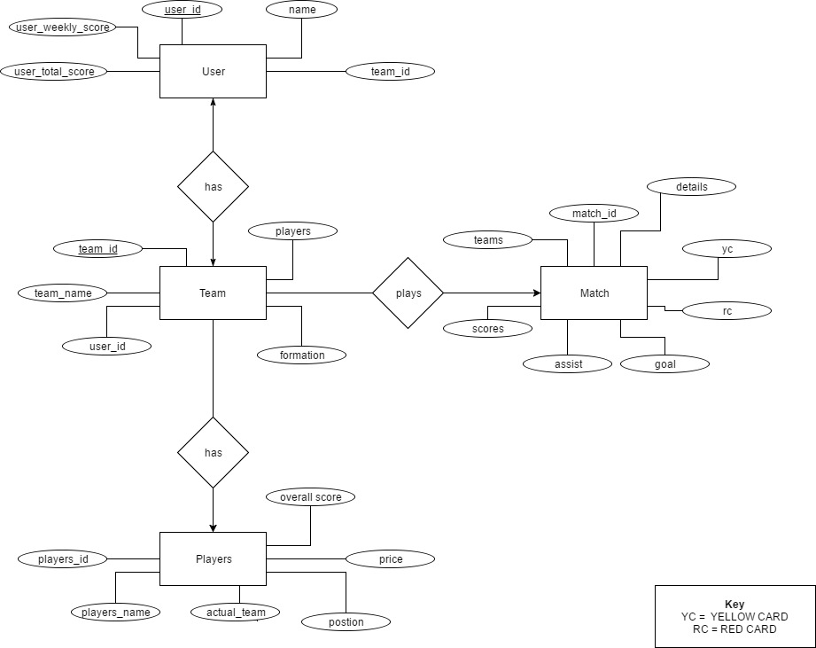
ER Diagram

Slide 16
Constraints/ Issues/ limitations
People are allowed to join only up to 4 weeks - Reason make it more competitive and allow for every player to have a fair and realistic chance of winning the league
Cost of labour to watch the matches and enter the information into the system
The points of users and league tables are only confirmed 2 hours after the last match of the week - reason is because the system has to wait on input from the admin and the sites to get updated
Only allowed to transfer players a day before the first match of the game week . Transfers are only allowed if a player is injured or dies.
Player prices will not change until the end of the season

